Slide 1
Crowd Detection and Analysis
By David Zeng
CE at CCNY
Mentor: Professor Hao Tang
Graduate Student Mentor: Greg Olmschenk

Slide 2
Overview
Background of project
Direction of the research
My contributions
Road blocks
Conclusion

Slide 3
Background
Rutgers crowd management simulation team
  Understanding crowd behavior from simulation
Crowd analysis people detection
Goal: Verify the simulation model with real statistics
Notes:
Understand crowd behavior from real life to compare to simulation model.
Because we want to understand crowd behavior we need to at least be able to detect people

Slide 4
Detection Process
New Images
Feature Points
Positives
Negatives
Inputs
Filters
Classifier
Training
Detector
Yes
No
Tracking Algorithm
Bounding Boxes
Evaluations
Results
Notes:
Upper body detection. Explain the whole pipeline, but use color to show each person’s individual contributions.
We want to teach the machine to learn to recognize something. We have to give examples of positives and negatives.

Slide 5
Machine Learning
People detection by Machine Learning approach
Inputs
New Images
Positives
Negatives
Classifier
Training
Detector
Yes
No
General flow diagram of machine learning process
Notes:
Upper body detection. Explain the whole pipeline, but use color to show each person’s individual contributions.
We want to teach the machine to learn to recognize something. We have to give examples of positives and negatives.

Slide 6
My work
Ground Truth
Evaluation
Camera calibration filter
Detection Box Tracking filter

Slide 7
What I have worked on
Ground truth creation
  VATIC – (Video Annotation Tool from Irvine, California)
Ground truth for :
  Machine Learning inputs
  Evaluation

Slide 8

Quick Example of VATIC

Slide 9
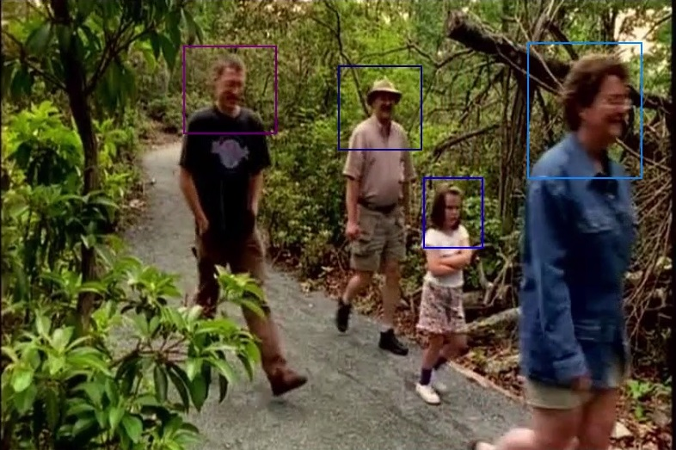
Quick Example of VATIC

Slide 10
What I have worked on
Evaluation code
  Precision
    (number of correct detections)/(total detections)
  Recall
    (number of correct detections)/(total ground truth)
  False Alarms
    incorrect detections from algorithm
  Miss Rate
    percentage of ground truth that is not detected

Slide 11
Example of Evaluation

Slide 12
What I have worked on (cont.)
Camera calibration filter
  Filtering based on camera space
Detection Box Tracking filter
  Filtering based on boxes following features

Slide 13
Camera Calibration Filtering

Slide 14
What I have worked on (cont.)
Camera calibration filter
  Filtering based on camera space
Detection Box Tracking filter
  Filtering based on boxes following features

Slide 15
Tracking Filtering
1
2
3
4

Slide 16
Tracking Filtering

Slide 17
Road Blocks
Laptop Issues
  Installing things on windows
  Dual booting issues and installing Linux
  Installing VATIC
  Laptop Failure
General coding frustrations
  Having to debug a convoluted mess of data structures
Image Compression

Slide 18
Conclusions
What I learned
  Rushing into things is not ideal
  How to use a debugger
  Spending extra time using good programming practices
  Various computer vision techniques
  Boring tedious work is still very important
Future work
  Modify evaluation code for new classifiers
  Rewrite tracking code in a cleaner form
  Optimize code
  More ground truth

Slide 19
References
Stock footage: Tourists_Hiking_in_the_Forest_Free_Footage.mov
  http://www.videezy.com/people/3414-tourists-hiking-in-the-forest-free-footage
Video Annotation Tool from Irvine, California (VATIC)
  web.mit.edu/vondrick/vatic/

Slide 20
Acknowledgments
CCIADA
DHS
DIMACS
Port Authority Bus Terminal
REU program
  Eugene Fiorini - Associate Director of DIMACS
  Matt Charnley - Graduate Coordinator
  Rebecca Coulson - Graduate Coordinator
Mentors
  Hao Tang
  Greg Olmschenk

